Slide 1
SmartTrafficManagement
PHASE- 1

Slide 2
CONTENT
01
Problem definition
02
Design thinking

Slide 3
CONTENT
01
Introduction
02
Problem
03
Rectification
04
Conclusion

Slide 4
ABSTRACT
Traffic light control systems are widely used to monitor and control the flow of automobiles through the junction of many roads. They aim to realize smooth motion of cars in the transportation routes.

Slide 5


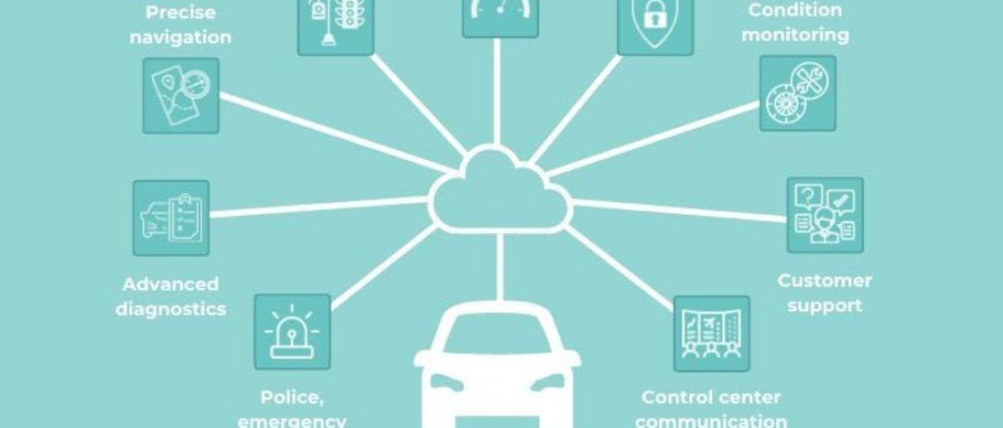
Traffic Management

Slide 6
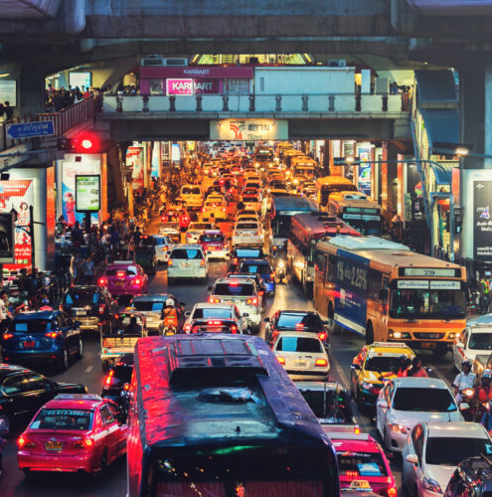
Traffic Management
Traffic management is a key branch within logistics. It concerns the planning, control and purchasing of transport services needed to physically move vehicles (for example aircraft, road vehicles, rolling stock and watercraft) and freight.

Slide 7
Problem
Traffic congestion can be caused by key factors such as accidents, traffic overload, construction and even pedestrians crossing the road incorrectly or holding up vehicles. In Tier 2 and Tier 3 cities, traffic congestion becomes worse due to bad roads, and poor connectivity among other factors.

Slide 8
Rectification
IR sensors are used as sensors to detect the density of traffic and Arduino is used as microcontroller. At traffic junction IR sensors are fitted at every side of the junction and sense the number of passing vehicle to each side of junction and interfaced to the arduino.

Slide 9
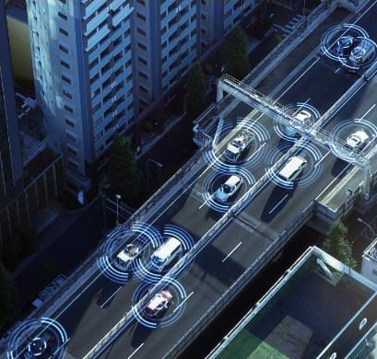

Slide 10
Final note
Even though road accident is very big emerging problem not only in this country but in other countries too we can overcome it by applying some simple preventive methods in our life and also advising others to apply those methods in tha life. As we know "PREVENTION IS BETTER THAN CURE".

